Slide 1
Chapter 2 Configuration Space
Chapter 3 Rigid-Body Motions
Chapter 4 Forward Kinematics
Chapter 5 Velocity Kinematics and Statics
Chapter 6 Inverse Kinematics
Chapter 7 Kinematics of Closed Chains
Chapter 8 Dynamics of Open Chains
Chapter 9 Trajectory Generation
Chapter 10 Motion Planning
Chapter 11 Robot Control
Chapter 12 Grasping and Manipulation
Chapter 13 Wheeled Mobile Robots

Slide 2
Important concepts, symbols, and equations
Forward kinematics of a serial chain:
Given
M = T_{sb}(0) ∈ SE(3), the configuration of the end-effector frame {b} at the home configuration 𝜃 = 0,
the screw axes for each joint at 𝜃 = 0, and
the joint vector 𝜃,
find T_{sb}(𝜃) ∈ SE(3).

Slide 3
Important concepts, symbols, and equations (cont.)
For screw axes S expressed in {s}, the product of exponentials (PoE) in the space frame is
For screw axes B expressed in {b}, the PoE is

Slide 4
Important concepts, symbols, and equations (cont.)
The Universal Robot Description Format (URDF) is an XML file describing the kinematics, inertial properties, and geometry of a tree-structured robot.
the joint element (kinematics) the link element (inertial properties)
J5
L5
J1
J2
L0
L1
L2
L3
L4
J3
J4
<joint name=“joint2” type=“revolute”>
<parent link=“link1”/>
<child link=“link2”/>
<origin rpy=“0 1.5708 0” xyz=“0 0.5 0”>
<axis xyz=“0 1 0”>
<limit lower=“-3.0” upper=“3.0”>
</joint>
<link name=“link2”>
<inertial>
<origin rpy=“0 0 0” xyz=”0 0 0.5”>
<mass value=“2.25”>
<inertia ixx=“1.0” ixy=“0” ixz=“0”
iyy=“2.0” iyz=“0” izz=“3.0”/>
</inertial>
</link>

Slide 5
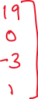

RRRP robot

Slide 6
Barrett Technology’s WAM 7R robot

Slide 7
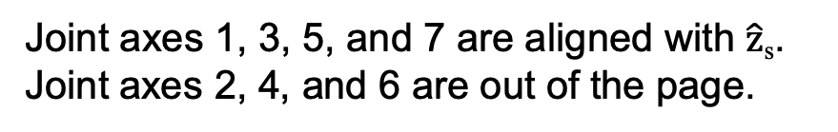
screw axes B_{i}
Joint axes 1, 3, 5, and 7 are aligned with $\hat{z}$_{s}.
Joint axes 2, 4, and 6 are out of the page.

Slide 8
screw axes S_{i}
Joint axes 1, 3, 5, and 7 are aligned with $\hat{z}$_{s}.
Joint axes 2, 4, and 6 are out of the page.

